Slide 1
210255: Principles of Programming Languages
Department of Computer Engineering

Slide 2
COURSE OUTCOME :
C216.1 | Use basic principles of programming languages.
Unit 1 Fundamentals of Programming
Importance of Studying Programming Languages, History of Programming Languages, Impact of Programming Paradigms, Role of Programming Languages, Programming Environments.
Impact of Machine Architectures: The operation of a computer, Virtual Computers and Binding Times.
Programming paradigms- Introduction to programming paradigms, Introduction to four main Programming paradigms- procedural, object oriented, functional, and logic and rule based.
Department of Computer Engineering

Slide 3

Unit 1 Fundamentals of Programming
Importance of Studying Programming Languages
Computers aren't very smart
Ask the computer to draw a picture of bird…
Will it draw?

Slide 4

Unit 1 Fundamentals of Programming
Importance of Studying Programming Languages
Computers are bad at understanding things
Department of Computer Engineering

Slide 5
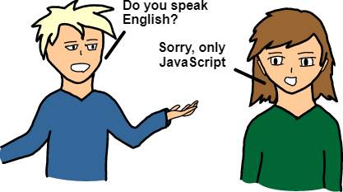
Unit 1 Fundamentals of Programming
Importance of Studying Programming Languages
Computers cannot understand English
Department of Computer Engineering

Slide 6
Unit 1 Fundamentals of Programming
Functional View of a Computer
CPU
Output Devices
Input Devices
Secondary Memory
Main Memory
Department of Computer Engineering

Slide 7
Unit 1 Fundamentals of Programming
Functional View of a Computer
Humans interact with computers via Input and Output (IO) devices
Information from Input devices are processed by the CPU and may be shuffled off to the main or secondary memory
When information need to be displayed, the CPU sends them to one or more Output devices
E.g., Keyboard
and mouse
E.g., Monitor
Output Devices
Input Devices
Department of Computer Engineering

Slide 8
Unit 1 Fundamentals of Programming
A program is just a sequence of instructions telling the computer what to do
Obviously, we need to provide these instructions in a language that computers can understand
We refer to this kind of a language as a programming language
Python, Java, C and C++ are examples of programming languages
Every structure in a programming language has an exact form (i.e., syntax) and a precise meaning (i.e., semantic)
Department of Computer Engineering

Slide 9
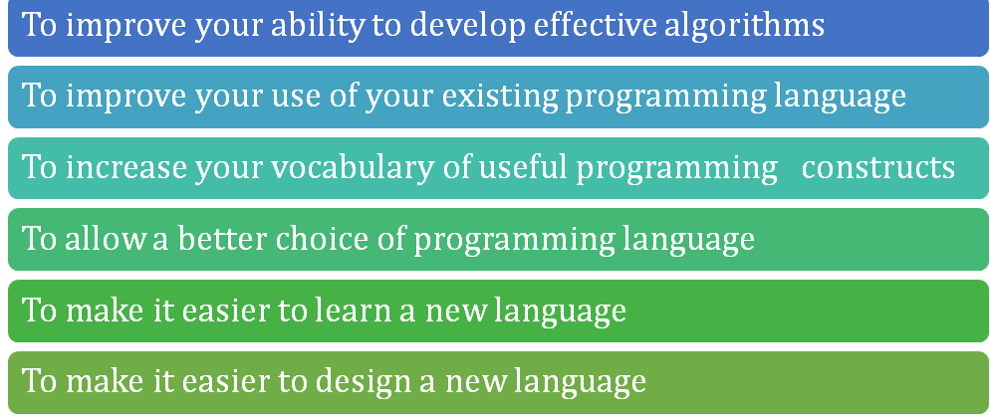
Unit 1 Fundamentals of Programming
Six reasons to Learn Programming Languages
Department of Computer Engineering

Slide 10
Unit 1 Fundamentals of Programming
Reason 1:
To improve your ability to develop effective algorithms
The depth at which people can think is heavily influenced by the expressive power of their language.
It is difficult for people to conceptualize structures that they cannot describe, verbally or in writing.
Eg recursion
Department of Computer Engineering

Slide 11
Unit 1 Fundamentals of Programming
Reason 2:
To improve your use of your existing programming language
Many professional programmers have a limited formal education in computer science, limited to a small number of programming languages.
They are more likely to use languages with which they are most comfortable than the most suitable one for a particular job.
Department of Computer Engineering

Slide 12
Unit 1 Fundamentals of Programming
Reason 3
Computer science is consider as a young discipline and most software technologies (design methodology, software development, and programming languages) are not yet mature. Therefore, they are still evolving.
The understanding of programming language design and implementation makes it easier to learn new languages..
Department of Computer Engineering

Slide 13
Unit 1 Fundamentals of Programming
Reason 4
It is often necessary to learn about language implementation; it can lead to a better understanding of why the language was designed the way that it was.
Fixing some bugs requires an understanding of implementation issues.
Department of Computer Engineering

Slide 14
Unit 1 Fundamentals of Programming
Reason 4
Some languages are better for some jobs than others.
(i) FORTRAN and APL for calculations, COBOL and RPG for report generation, LISP and PROLOG for AI, etc.
Improve your use of existing programming language
By understanding how features are implemented, you can make more efficient use of them.
Department of Computer Engineering

Slide 15
Unit 1 Fundamentals of Programming
Reason 5
To improve your use of existing programming language
By understanding how features are implemented, you can make more efficient use of them.
Examples:
Creating arrays, strings, lists, records.
Using recursions, object classes, etc.
Department of Computer Engineering

Slide 16
Unit 1 Fundamentals of Programming
Reason 6
Designing a new language require prior knowledge of previous one to make it effective, efficient and convenient to users.
The previous knowledge as well as concepts are usual to design a new language irrespective of their work domains.
Department of Computer Engineering

Slide 17
Unit 1 Fundamentals of Programming
History of Programming languages
Click Here for Video
Department of Computer Engineering

Slide 18
Unit 1 Fundamentals of Programming
How to Solve a Problem
Defining the System
Analyzing the system defined
Detailed System Specification
Design the system
Implement the design
Testing and Debugging
Validation
Department of Computer Engineering

Slide 19
Good Program
Time
Cost
Quality

Slide 20
Unit 1 Fundamentals of Programming
History of Programming languages
Department of Computer Engineering

Slide 21
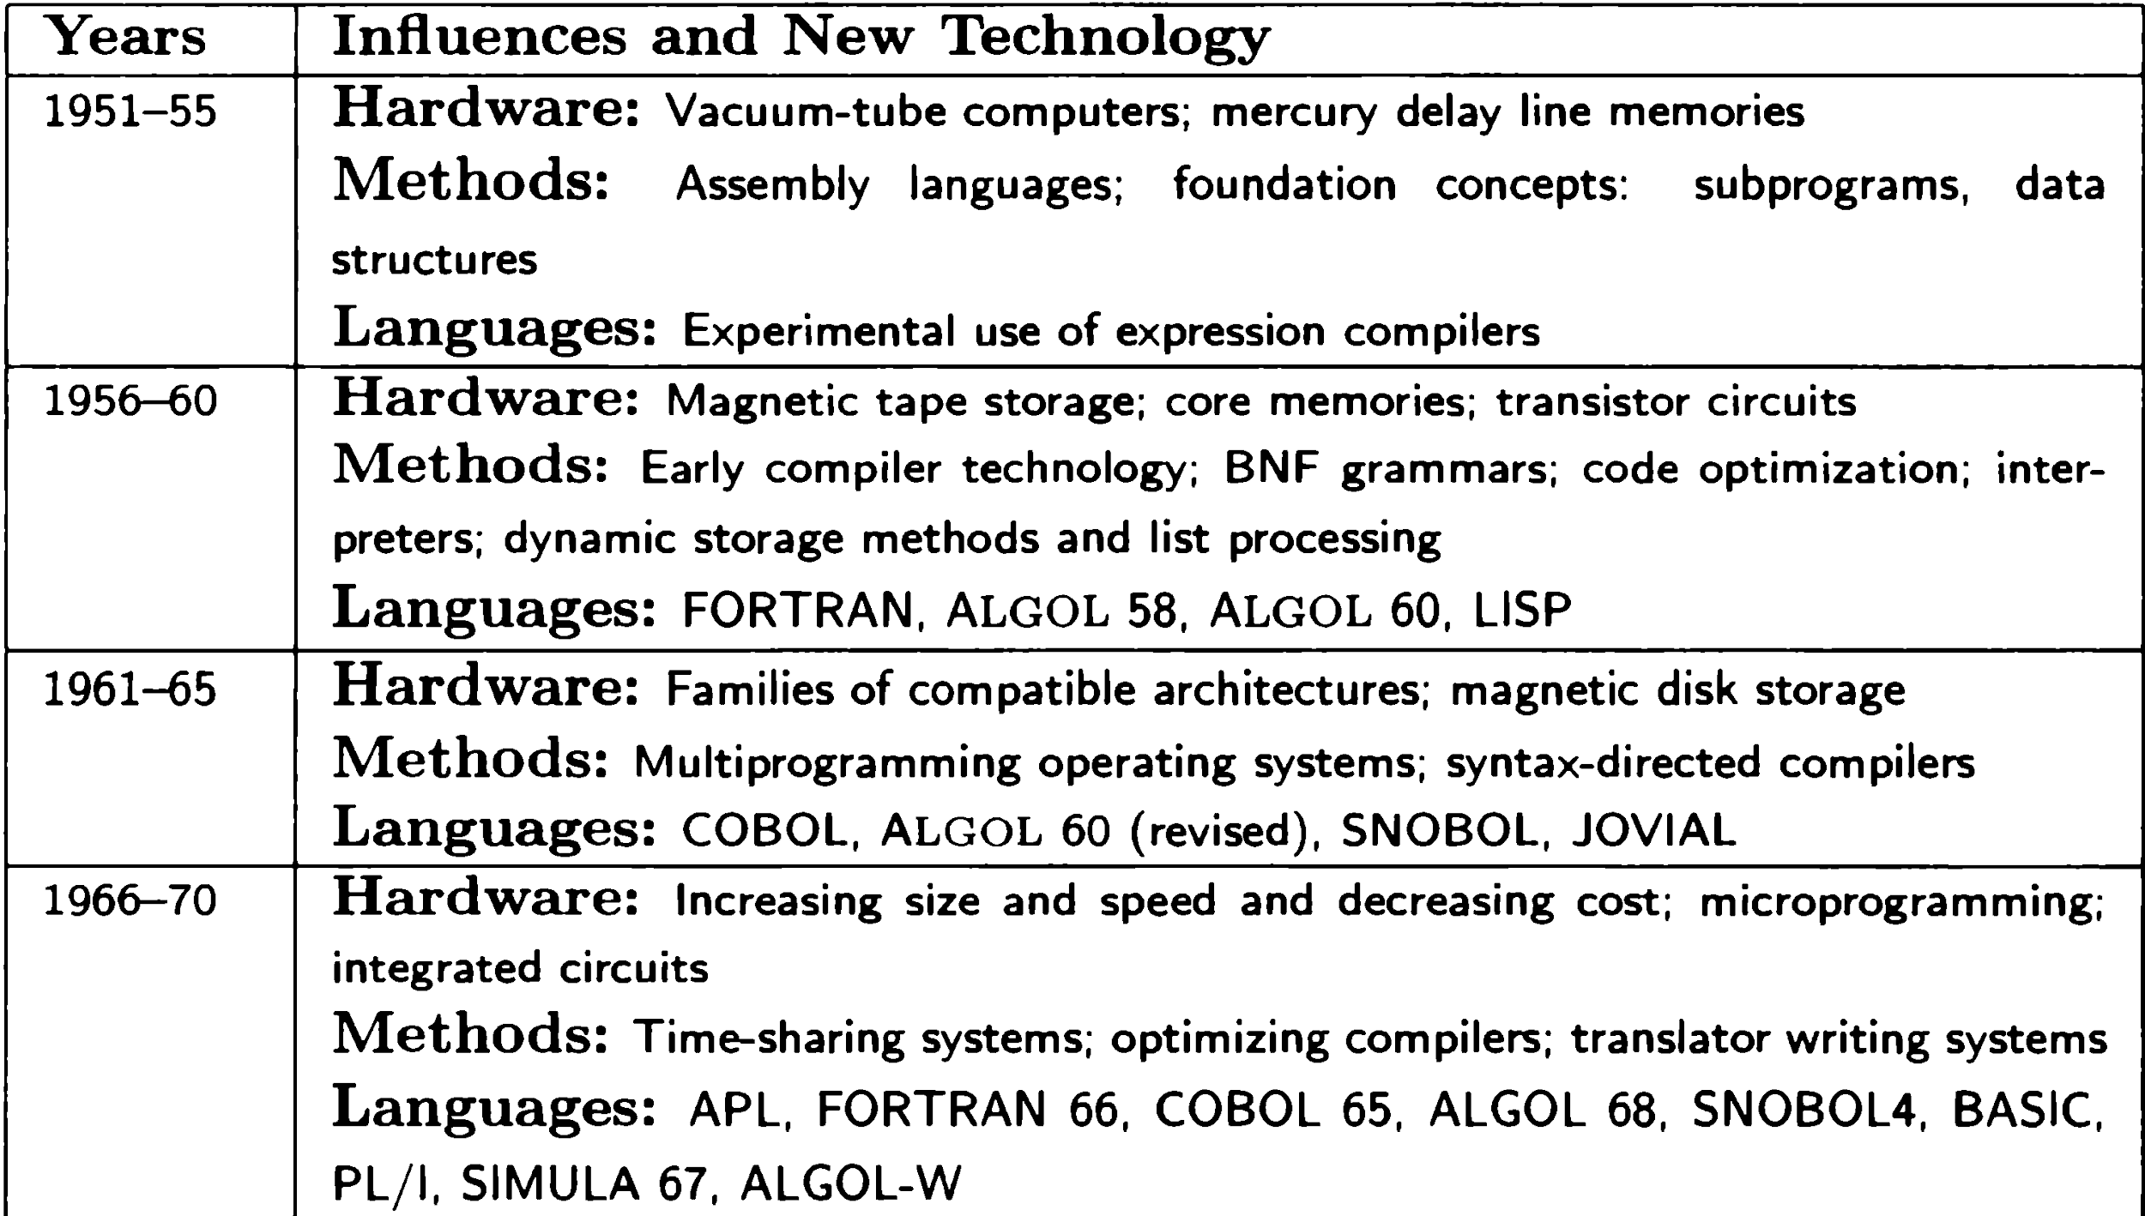
Unit 1 Fundamentals of Programming
Some influences on the development of Programming Languages
Department of Computer Engineering

Slide 22
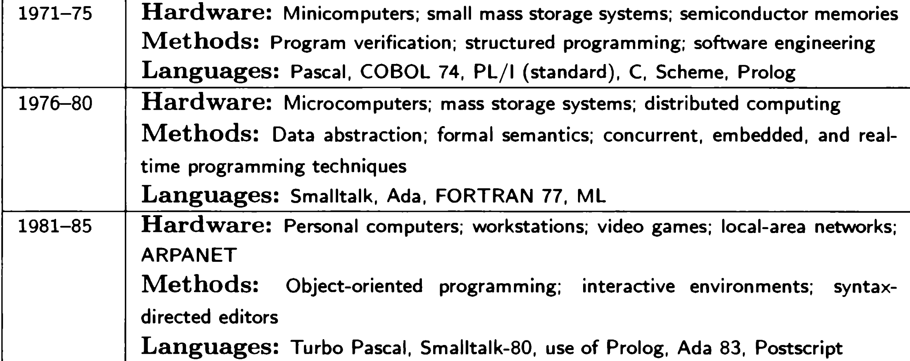
Unit 1 Fundamentals of Programming
Some influences on the development of Programming Languages
Department of Computer Engineering

Slide 23
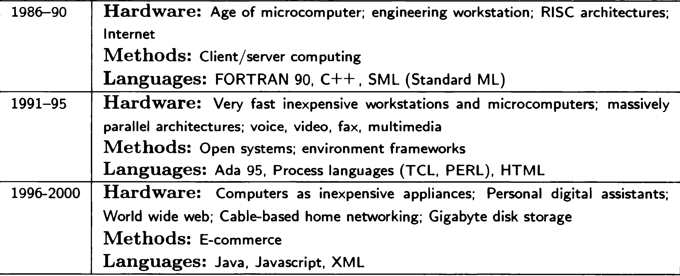
Unit 1 Fundamentals of Programming
Some influences on the development of Programming Languages
Department of Computer Engineering

Slide 24
Unit 1 Fundamentals of Programming
Attributes of a good language
Clarity, simplicity, and unity.
Orthogonality.
Naturalness for the application.
Support of abstraction.
Ease of program verification.
Programming environments.
Portability of programs.
Department of Computer Engineering

Slide 25
Unit 1 Fundamentals of Programming
Clarity, Simplicity And Unity
A Programming language provides both a conceptual framework for Algorithm planning and means of expressing them.
It should have
•minimum number of different concepts
•with Rules
•simple and regular.
This attribute is called conceptual integrity.
Department of Computer Engineering

Slide 26
Unit 1 Fundamentals of Programming
Orthogonality
It is one of the most important feature of PL orthogonality is the property that means " Changing A does not change B".
e.g. Radio
Department of Computer Engineering

Slide 27
Unit 1 Fundamentals of Programming
Support for Abstraction
There is always found that a substantial gap remaining between the abstract data structure and operations that characterize the solution to a problem
Department of Computer Engineering

Slide 28
Unit 1 Fundamentals of Programming
Programming Environment
An appropriate programming environment adds an extra utility and make language to be implemented easily
The availability of- Reliable- Efficient - Well documentation to speed testing
Facility- Maintaining and Modifying- Multi Version
Department of Computer Engineering

Slide 29
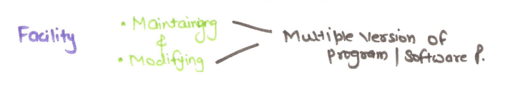
Unit 1 Fundamentals of Programming
Programming Environment
Department of Computer Engineering

Slide 30
Unit 1 Fundamentals of Programming
Ease of program verification:- Reusability:
The reusability of program written in a language is always a central concern. A program is checked by various testing technique like
Formal verification method Desk checking Input output test checking.
We verify the program by many more techniques.
Simplicity of semantic and syntactic structure is a primary aspect that tends to simplify program verification.
Department of Computer Engineering

Slide 31
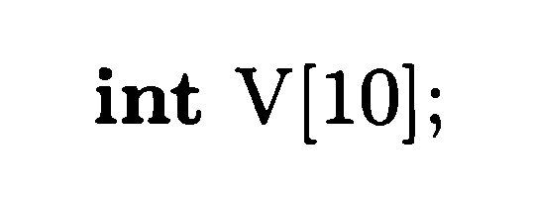
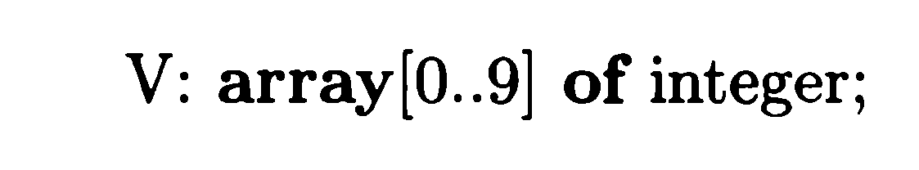
Unit 1 Fundamentals of Programming
Syntax and Semantics
The syntax of programming language is what the program looks like.
How statements declaration and other constructs are written
The semantic of PL is meaning is a meaning given to the various syntactic constructors.
Department of Computer Engineering

Slide 32










Programming language qualities
Software must be reliable ( no failure)
Software must be maintainable(new requirements be easily added ..or modified
Software must be efficient( speedy and less space)

Slide 33










Reliability is achieved by..
Writability
Readabililty Simplicity Safety Robustness
Higher-level languages are more writable than low-level
Provision of adding new operations and data types easily
enhances readability
Allow algorithms to be expressed easily, Eg. Pascal is simpler than C++ but less powerful
If language provides no features that make it possible to write harmful programs..like goto then its safe
Ability to deal with undesired events like arithmetic overflow.

Slide 34
Maintainability is achieved by….
Factoring Locality

Slide 35

Language and Efficiency..
Efficiency earlier was measured by execution
speed and space
Now-a-days we can measure it by combined
quality of language and its implementation
If a language does not allow optimization it may adversely affect efficiency

Slide 36
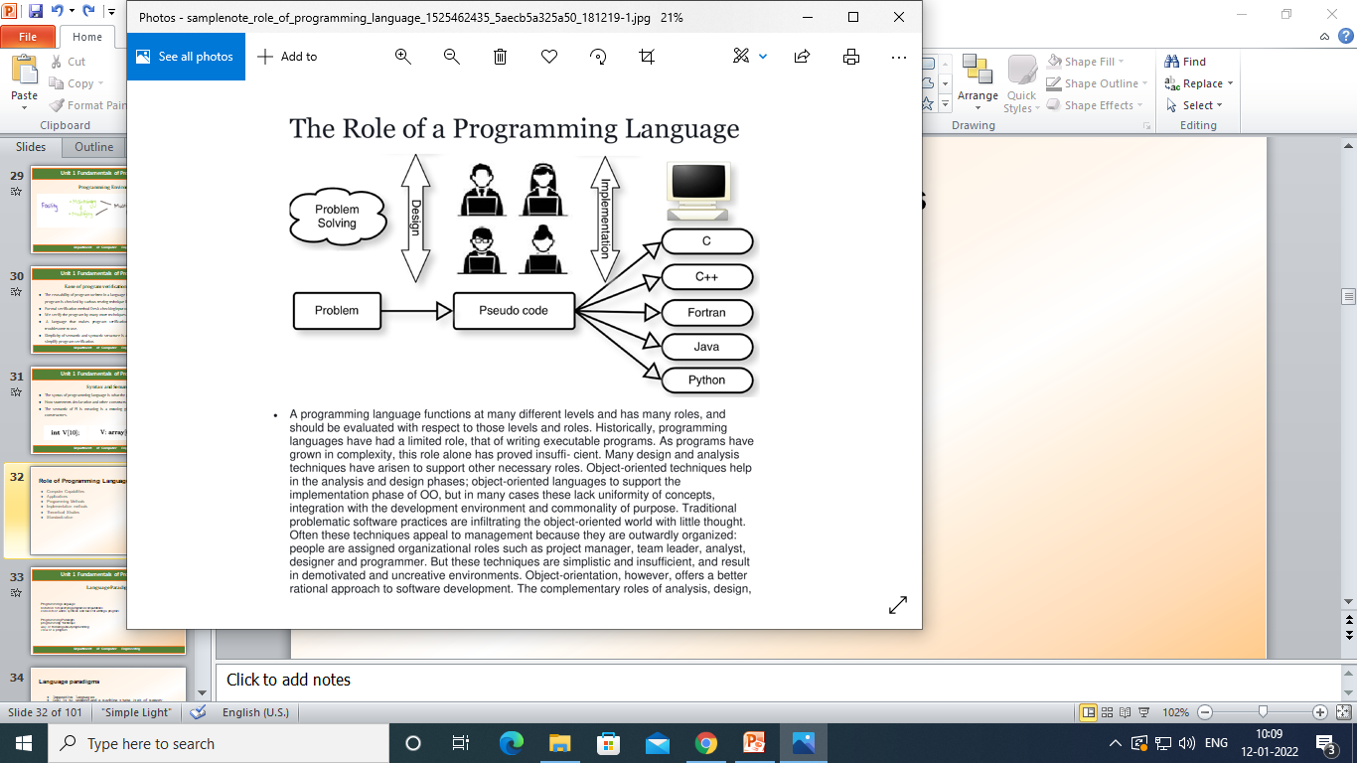
Role of Programming Languages
Computer Capabilities
Applications
Programming Methods
Implementation methods
Theoretical Studies
Standardization

Slide 37
Role of Programming Languages
Computer capabilities : Hardware and OS
Applications : Wide area of applications
Programming methods: Multiprogramming, interactive systems, data abstraction, formal semantics, OO programming
Implementation methods: The development of better implementation methods has affected the choice of feature to include in new language designs.
Theoretical studies: Deep research using formal mathematical methods for understanding of the strengths and weaknesses of language features which has influence the inclusion of these features in new language designs
Standardization: Need for standard languages that can be implemented easily on a variety of computer systems. Has provided a strong conservative influence on the evolution of language design

Slide 38
Unit 1 Fundamentals of Programming
Language Paradigms
Programming Language
notation for specifying programs/computations
consists of words, symbols, and rules for writing a program
Programming Paradigm
programming “technique”
way of thinking about programming
view of a program
Department of Computer Engineering

Slide 39
Language paradigms
Imperative languages
Goal is to understand a machine state (set of memory locations, each containing a value)
Statement oriented languages that change machine state (C, Pascal, FORTRAN, COBOL)
Syntax: S1, S2, S3, ...
Applicative (functional) languages
Goal is to understand the function that produces the answer
Function composition is major operation (ML, LISP)
Syntax: P1(P2(P3(X)))
Programming consists of building the function that computes the answer

Slide 40
Language paradigms (continued)
Rule-based languages
Specify rule that specifies problem solution (Prolog, BNF Parsing)
Other examples: Decision procedures, Grammar rules (BNF)
Syntax: Answer → specification rule
Programming consists of specifying the attributes of the answer
Object-oriented languages
Imperative languages that merge applicative design with imperative statements (Java, C++, Smalltalk)
Syntax: Set of objects (classes) containing data (imperative concepts) and methods (applicative concepts)

Slide 41
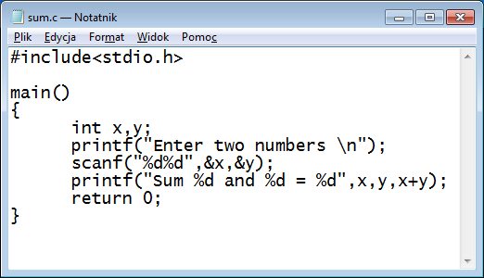
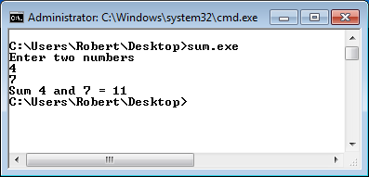
Unit 1 Fundamentals of Programming
Programming Paradigms- Imperative
use mnemonics to represent machine instructions
ØEach statement in assembly language corresponds to one statement in machine language.
ØAssembly language programs have the same advantages and disadvantages as machine language programs.
Compare the following machine language and assembly language programs:
Department of Computer Engineering

Slide 42
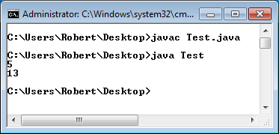
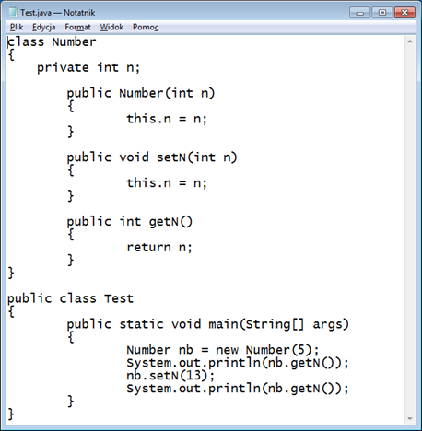
Unit 1 Fundamentals of Programming
Programming Paradigms- Object Oriented
use mnemonics to represent machine instructions
ØEach statement in assembly language corresponds to one statement in machine language.
ØAssembly language programs have the same advantages and disadvantages as machine language programs.
Compare the following machine language and assembly language programs:
Department of Computer Engineering

Slide 43
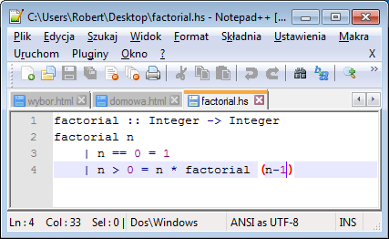
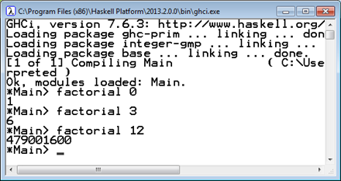
Unit 1 Fundamentals of Programming
Programming Paradigms- Functional Programming
Department of Computer Engineering

Slide 44
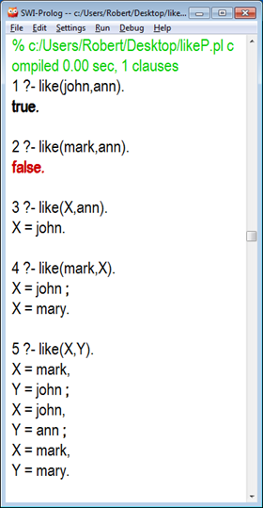
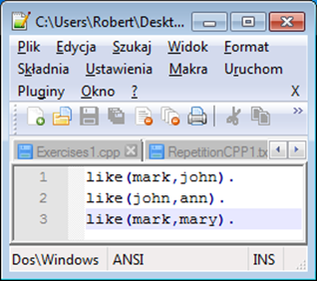
Unit 1 Fundamentals of Programming
Programming Paradigms- Logical programming
use mnemonics to represent machine instructions
ØEach statement in assembly language corresponds to one statement in machine language.
ØAssembly language programs have the same advantages and disadvantages as machine :
Department of Computer Engineering

Slide 45
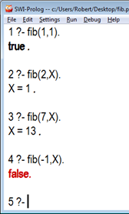
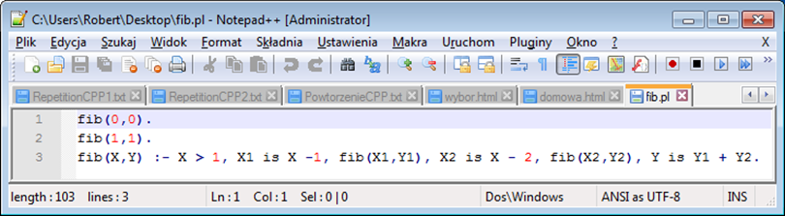
Unit 1 Fundamentals of Programming
Programming Paradigms- Logical programming
use mnemonics to represent machine instructions
ØEach statement in assembly language corresponds to one statement in machine language.
ØAssembly language programs have the same advantages and disadvantages as machine :
Department of Computer Engineering

Slide 46
Concept of binding
A binding in a program is an association of an attribute with a program component such as an identifier or a symbol.
For example the data type of the value of a variable is an
attribute that is associated with the variable name.
The binding time for an attribute is the time at which the binding occurs.
For example, in C the binding time for a variable type is when the program is compiled but the value of the variable is not bound until the program executes

Slide 47
Binding Times
The most common binding times for attributes are (in chronological order):
Language definition
Language implementation
Program translation (compile time)
Link edit
Load
Program execution (run time)

Slide 48
Binding Times
1. Language definition time--- Possible statement forms, data structure types, program structures. (integer type definition)
2. Language implementation time --The details associated with the representation of numbers and of arithmetic operations. (integer type memory representation)
3. Translation time (compile time)--- Bindings chosen by the programmer , Bindings chosen by the translator
4. Link time: the time at which multiple object codes ( machine code files) and libraries are combined into one executable
5. Load time: the time at which the operating system loads the executable in memory
6.Execution time (run time) (dynamic binding) ---Binding of variables to values by assignments. (can be modified repeatedly during execution)

Slide 49
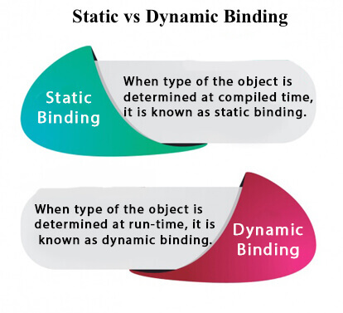
Department of Computer Engineering

Slide 50
Binding Times
Attribute | Binding time
Type of a variable identifier | Translation (Compile)
Value of a variable identifier | Execution (Run-time)
General meaning of + | Language design time /Definition
Specific meaning of + | Translation(compile )
Meaning of literal (constant) 23 | Language definition
Internal representation of literal 23 | Language implementation
Specific computation performed by an external function | Link time
Value of a "global" data identifier | Execution(Run Time)

Slide 51
Unit 1 Fundamentals of Programming
Programming Environment
Effects on Language Design
Environment Frameworks
Job Control and Process Languages
Department of Computer Engineering

Slide 52
Unit 1 Fundamentals of Programming
Programming Environment-Effects on Language Design
SEPARATE COMPILATION
subprograms or other parts can be separately compiled and executed
later merged without change into the final program.
compiler may need information about other subprograms or shared data
type of parameters ,external variable, local variable within the subprogram
Department of Computer Engineering

Slide 53
Unit 1 Fundamentals of Programming
Programming Environment-Effects on Language Design
another aspect of separate compilation that affects language design
shared name
scoping rules
Inheritance
Testing and debugging.
Execution trace features.
Breakpoints.
Assertions.
assert( X>0 and A=1) or (X=0 and A>B+10).
Department of Computer Engineering

Slide 54
Unit 1 Fundamentals of Programming
Programming Environment- Environment Frameworks
support environment consists of infrastructure services called the environment framework
supplies services such as a data repository, graphical user interface, security, and communication services.
Department of Computer Engineering

Slide 55
Unit 1 Fundamentals of Programming
Programming Environment- Job Control and Process Languages
If the compilation fails, the user could invoke an editor to correct the Program;
If the compilation succeeds, the user could invoke a loader and execute
the program.
a process or scripting language which generally interpret
“faster, better, and cheaper.”
Department of Computer Engineering

Slide 56
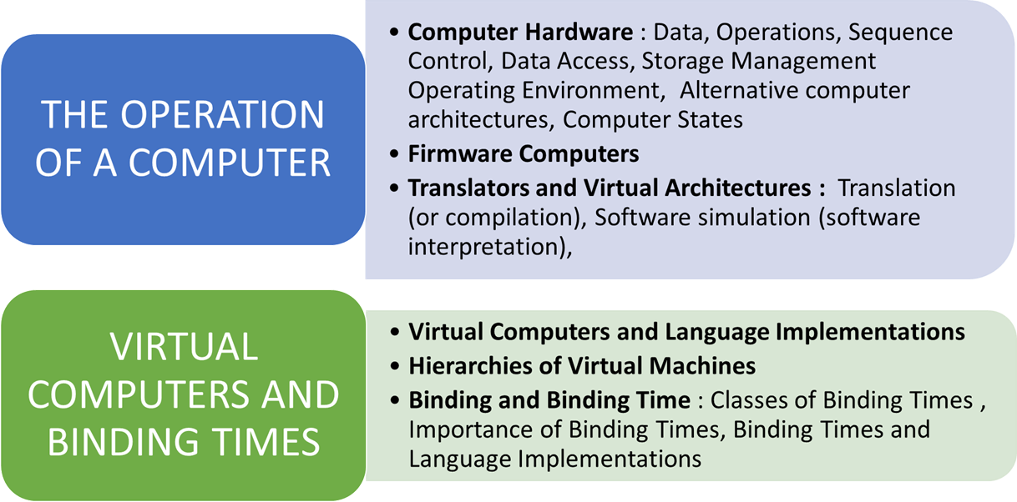
Unit 1 Fundamentals of Programming
Impact of Machine Architectures
Department of Computer Engineering

Slide 57
Unit 1 Fundamentals of Programming
Impact of Machine Architectures - THE OPERATION OF A COMPUTER
Computer Hardware
Data. A computer must provide various kinds of elementary data items and data structures to be manipulated.
Primitive operations. A computer must provide a set of primitive operations useful for manipulating the data.
Sequence control. A computer must provide mechanisms for controlling the sequence in which the primitive operations are to be executed.
Data access. A computer must provide mechanisms for controlling the data supplied to each execution of an operation.
Storage management. A computer must provide mechanisms to control the allocation of storage for programs and data
Operating environment. A computer must provide mechanisms for communication with an external environment containing programs and data to be processed.
Department of Computer Engineering

Slide 58
Unit 1 Fundamentals of Programming
Impact of Machine Architectures - THE OPERATION OF A COMPUTER
Firmware of Computers
common alternative to the strict hardware realization of a computer is the firmware computer simulated by a microprogram running on a special micro programmable hardware computer.
Microprogram simulation of a computer is sometimes termed emulation.
Department of Computer Engineering

Slide 59
Unit 1 Fundamentals of Programming
Impact of Machine Architectures - THE OPERATION OF A COMPUTER
Translators and Virtual Architectures
translator could be designed to translate programs in the high-level language into equivalent programs in the machine language of the actual computer.
Department of Computer Engineering

Slide 60
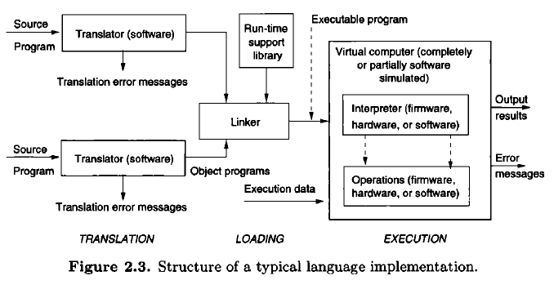
Unit 1 Fundamentals of Programming
Impact of Machine Architectures - THE OPERATION OF A COMPUTER
Translators
Department of Computer Engineering

Slide 61
Unit 1 Fundamentals of Programming
Impact of Machine Architectures - THE OPERATION OF A COMPUTER
Translators and Virtual Architectures
The common division of languages
Compiled languages : translated into the machine language of the actual computer
being used before execution begins, eg. C, C++, FORTRAN, Pascal, and Ada are
Interpreted languages : In such a language implementation, the translator does not produce machine code for the computer being used. Instead, the translator produces some intermediate form of the program that is more easily executable than the original program form yet that is different from machine code.
Java and the WWW have changed some of these rules.
Department of Computer Engineering

